Slide 1
Week-10 web Application Quality and Testing
Course Instructor:
HARIS aHMED
SIR SYED UNIVERSITY OF ENGINEERING & TECHNOLOGY

Slide 2
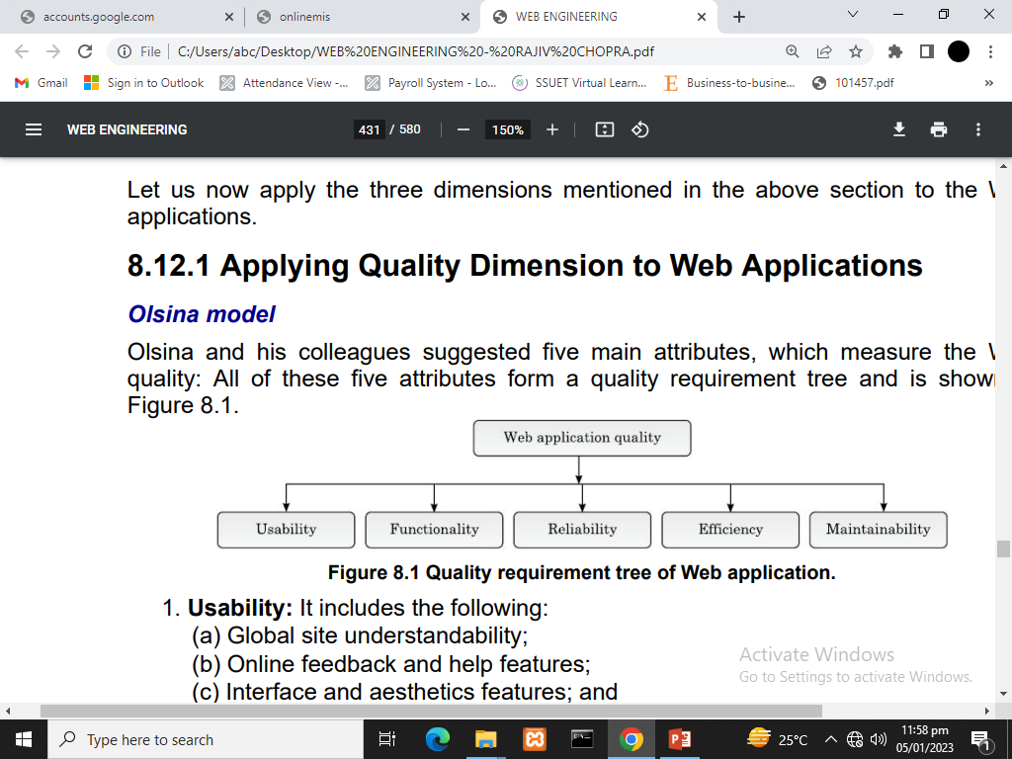
Applying Quality Dimension to Web Applications
Olsina model
Olsina and his colleagues suggested five main attributes, which measure the Web quality: All these five attributes form a quality requirement tree and is shown as:

Slide 3
Applying Quality Dimension to Web Applications
Efficiency: It includes the following:
Response time performance;
Page generation speed; and
Graphics generation speed.
Maintainability: It includes the following:
Ease of correction;
Adaptability; and
Extensibility.
Usability: It includes the following:
Global site understandability;
Online feedback and help features;
Interface and aesthetics features; and Special features.
Functionality: It includes the following:
Searching and retrieving capability;
Navigation and browsing features; and
Application domain-related features.
Reliability: It includes the following:
Correct link processing;
Error recovery; and
User input validation and recovery.
Notes:
Extensibility: the quality of being designed to allow the addition of new capabilities or functionality.

Slide 4
Web testing-introduction
Web testing is the process of executing the Web code with the intent of finding faults.
It is an umbrella activity. It means that Web site testing should be carried out throughout the Web software development life cycle (WSDLC).
So, Web testing can be done right from the Web requirements analysis phase, to Web design, Web coding, Web testing till Web maintenance phase.
During Web requirements analysis, even the requirements document needs to be validated.
Similarly, Web design documents needs to be tested. But this type of Web testing will be static Web testing.
During Web coding phase, Web code written using Web technologies needs to be tested.

Slide 5
Web testing-introduction
The basic unit of any Web site or a Web application is a Web page, or simply, a page.
The navigational links between these Web pages must be carefully tested. If this is not done, then the Web site may fail at any time.
Both functional and non-functional aspects of the Web applications should also be considered while testing.
Both black-box testing and white-box testing of Web sites must be done. Testing can be done at various levels.
Gray-box testing may involve 80% of the black-box testing and 20% of the white-box testing or 20% of the black-box testing and 80% of the white-box testing (80–20 rule).
A Web tester can start from unit testing of the modules, and then, go till system and acceptance level tests.
Web pages are the documents of texts, pictures, sounds, videos and hyperlinks. Web users can navigate from page to page using them as links

Slide 6
Black Box Testing
Black box testing is a software testing method where the internal code structure is NOT visible to the tester.
The tester only knows the inputs and checks the outputs without knowing how the system processes the data.
It focuses on functional requirements and user experience rather than internal code logic.
Testers do not need programming knowledge or coding skills to perform black box testing.
Examples include testing login forms, search features, and user interfaces by giving inputs and verifying outputs.
Black box testing is also known as behavioral testing or specification-based testing.

Slide 7
White Box Testing
White box testing is a software testing method where the internal code structure IS visible to the tester.
The tester examines the internal logic, code paths, branches, loops, and conditions of the software.
It focuses on code coverage, statement coverage, branch coverage, and path coverage to find hidden defects.
Testers need programming knowledge and coding skills to perform white box testing effectively.
Examples include testing individual functions, conditional statements (if/else), loops, and variable initialization.
White box testing is also known as glass box testing, clear box testing, or structural testing.

Slide 8
TERMINOLOGY OF WEB SITE TESTING
The following terms are used during Web site and Web application testing:
Web site testing: It is the process of executing the Web site or a Web application with the intent of finding faults.
Orphan pages: These are the Web pages, which are the part of a Web site, but they cannot be accessed through hyperlinks, as they are not hooked up.
Test case: Inputs, execution conditions, expected results ("Login test" with email, password)
Test suite: A collection of many test cases forms a test suite.
Refactoring: It is the process of redesigning a program while keeping the semantics to reduce redundancies and increase the design quality. (clean code )
Test-first development: In this, the tests are written first, and then, for each of that specific test, the source code is written

Slide 9
TERMINOLOGY OF WEB SITE TESTING
Broken links: The links within a hypertext navigation structure, which point to a non-existing node (pages, images, etc.) or anchor, are called broken links.
Browser testing: To discover errors in Web applications, which are caused due to incompatibilities between different Web browsers is known as browser testing.
Test case tools: These are the automated tools that are used to test any Web site or any Web application like Selenium, Cypress, Playwright
Security testing: To locate the vulnerable points in a Web application, security testing is performed.

Slide 10
TEST LEVELS
A Web site or a Web application software development life cycle involves five phases as follows:
Phase 1: Web requirement analysis;
Phase 2: Web design;
Phase 3: Web coding (using Web technologies);
Phase 4: Web testing; and
Phase 5: Web maintenance.
In each of these phases, we can do one or the other form of testing.
During phase 1, we can verify the software requirements document (SRS) by using static testing techniques like reviews, feedbacks, meetings, brainstorming sessions, etc., but this will be static testing, as only Web documents are being tested. During Web design phase, the software design document (SDD) may be verified.

Slide 11
Types of testing
Unit tests: Testing the “atomic” units - classes, Web pages, etc. - independently. (Developer)
Integration tests: Test the interaction of units (Tester & Developer)
System tests: Testing the whole, integrated system (Dedicated team)
Acceptance tests: “Real-world” tests – testing under conditions that are as close to the live environment as possible (Client)
Beta tests: Informal, product-wide tests conducted by “friendly” users.

Slide 12
1) Unit testing
Unit testing is a software testing technique where individual units (smallest testable parts) of a program are tested in isolation to ensure they work correctly. A "unit" is typically a function, method, or class.
Verify that each unit behaves as expected.
Catch bugs early.
Make refactoring safer.
Serve as live documentation.

Slide 13
2) Integration tests
Integration testing verifies that multiple software modules/units work together correctly. While unit tests isolate individual functions, integration tests check the interactions between components (e.g., database, API, file system, other services).
Detect interface defects (wrong data formats, mismatched parameters)
Verify data flow between modules
Catch issues unit tests miss (e.g., real database constraints)
Validate external service integration

Slide 14
3) System tests
System testing tests the complete, integrated application as a whole to verify it meets specified requirements. It validates the system against functional and non-functional requirements in an environment that mimics production.
Test system-wide behavior (not just component interactions)
Verify against requirements specification
Test non-functional aspects (performance, security, usability)

Slide 15
4) Acceptance tests
Acceptance testing verifies whether the entire system meets business requirements and is ready for delivery to end users. It answers: "Did we build the right thing?" (vs. system testing which asks "Did we build it right?")
Validate against user needs and business goals
Determine if the software is ready for production
Provide confidence to stakeholders for release sign-off
Test real-world workflows from user perspective

Slide 16
5) Beta Testing
Beta testing is a type of acceptance testing where a nearly-complete version of the software (beta version) is released to a limited group of real users in their real environments to discover issues that internal testing couldn't uncover.
Get feedback from actual users before full launch
Discover edge cases from real usage patterns
Validate product-market fit
Build early user goodwill and advocates
Identify performance/scalability issues at scale

Slide 17
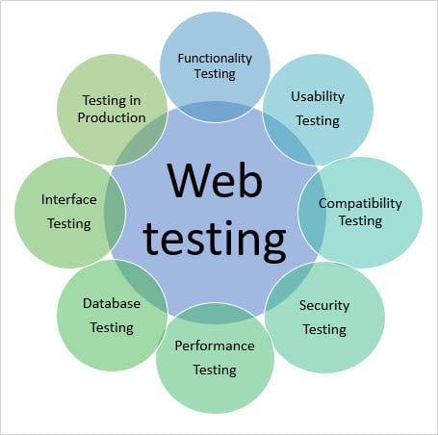
METHODS AND TECHNIQUES TO TEST WEB APPLICATIONS How can I test my Web application?

Slide 18
Summary
Web testing is a software testing practice to test websites or web applications for potential bugs. It's a complete testing of web-based applications before making live. A web-based system needs to be checked completely from end-to-end before it goes live for end users.
By performing website testing, an organization can make sure that the web-based system is functioning properly and can be accepted by real-time users.

Slide 19
Bibliography
Mandatory reading
Chapter 7-Testing Web Applications

